Slide 1
BLOCKCHAIN TECHNOLOGY FOR AGRICULTURAL SUPPLY CHAIN

Slide 2
ABSTRACT
In this project we are using IOT network and Blockchain security technology in agriculture food supply chain.
In propose work IOT network will be setup in agriculture farms and this IOT will sense food quality growing farms and then report to its nearest cluster head and cluster head will report to base station.
Base station will collect food quality data from Cluster Head and then store that data in decentralized Blockchain nodes.
This data can be access by various users such as distributors, suppliers, farmers and consumers to know the quality of the food
Above Blockchain technology helps in detecting attack nodes and make data secured.
KEYWORDS
Agricultural supply chain; Blockchain; Cryptographic methods; Food production.

Slide 3
CONTENTS
Introduction
Abstract and Keywords
Problem Statement
Algorithm
Architecture
Process

Slide 4
INTRODUCTION
Due to globalization in various fields, agriculture sector is calling for new techniques and innovations. One such technology is blockchain.
Firstly, blockchain technology is an application of distributed ledger technology. It consists of associated chains that store data in units called blocks.
What makes blockchain technology different from others is its unique properties like decentralization, traceability, transparency and cryptography.
A supply chain refers to the design, engineering production and distribution process of goods from suppliers to consumers [1].
These supply chain are prone to error, hacking and they are over reliant on the centralized database(single point failure problem).
Another major drawback is high costs when involving a third party to verify and monitor transactions.
To solve these issues, cryptographic techniques and other advanced systems are used in blockchain technology.
Fig 1 describes the various applications of block chain technology in agricultural sector.

Slide 5
Blockchain Technology
Blockchain :
Blockchain is a decentralized and distributed ledger technology that enables secure, transparent, and tamper-resistant record-keeping of transactions.
1. Decentralization: Unlike traditional centralized systems, blockchain operates 2. Blocks and Chain: Transactions are grouped together into blocks, and each block contains a reference to the previous block, creating a chain of blocks. 3. Consensus MechanismCommon consensus mechanisms include Proof of Work (used by Bitcoin) and Proof of Stake.
4.*Smart Contracts*These are self-executing contracts with the terms of the agreement directly written into code.
5. Transparency and Immutability: Transactions recorded on the blockchain are visible to all participants in the network, promoting transparency.

Slide 6
Agricultural Supply Chain
An agricultural supply chain is a series of activities that start with production and end with distribution. It involves the following stages: Production, Processing, Storage, Transportation, Distribution.
The typical agricultural supply chain involves three steps:
From farmers to intermediate silos
From silos to transformation plants
From transformation plants to clients

Slide 7
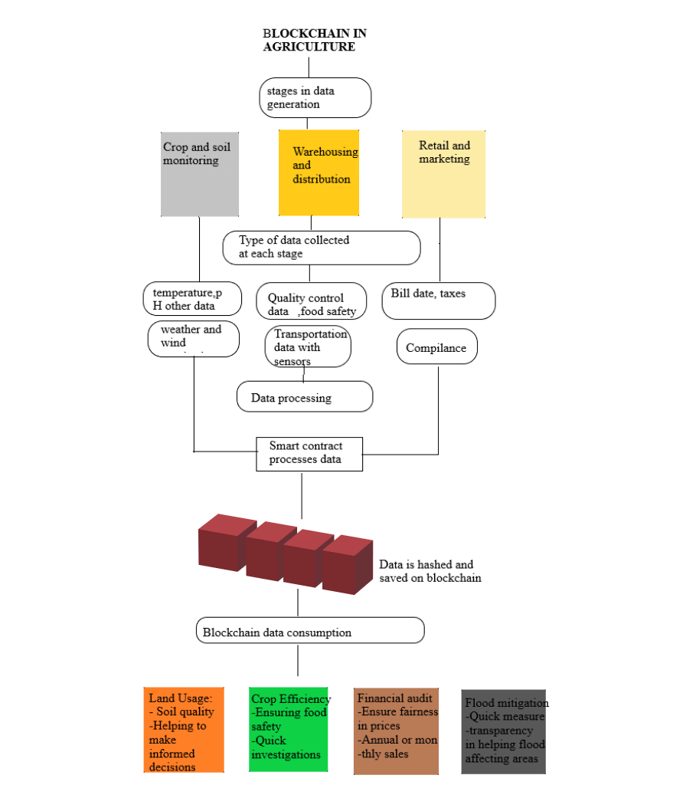
Fig 1:

Slide 8
PROBLEM STATEMENT
Our project elaborates the major challenges faced by the agriculture industry namely, the food production and food supply chain inefficiency.

Slide 9
Existing Techniques and Drawbacks
All existing techniques were using centralized server (single main server) to store data and if this server hack by malicious users then they can easily alter data on that servers and user’s may get wrong or fake data and there is no proper software to detect that alteration and to overcome from this problem Blockchain technology has been introduced.
Blockchain support decentralized (data stores at multiple nodes) storage and each node will store data as block of transaction by associating each block with hash code and whenever new data arrive for storage then all nodes will verify hashcode of existing blocks and if all nodes contains same hashcode then data will be consider as secured and unaltered and then new block will be added.
If any node report incorrect hashcode then that node consider as attacked and then collect data from genuine nodes. Above verification of hashcode is consider as PROOF OF WORK.

Slide 10
Algorithm In propose work we are using IOT networks and this IOT network consists of following operations 1. Generate Network: using this module IOT network will get setup 2. Cluster Head Selection: all IOT networks exchange there available battery power and then check which IOT covering more number of nodes and can reached to base station with less energy consumption then that node will be elected as cluster head. 3. Collect Data: using this module IOT will collect/sense food data from agriculture farm. 4. Data Transmission Routing Phase: using this module IOT will find shortest path to reached cluster head and then transfer data to selected cluster head. CH will send data to base station. Base station will collect data and then store in Blockchain node. Blockchain store each data as block of transaction and will generate hashcode for verification 5. View Blockchain Data: various users such as consumer, farmers, distributors and many more users may use this module to retrieve data from Blockchain and view it. In this project they have used IOT sensors and agriculture field but we don’t have any sensors so we built this concept as simulation.

Slide 11
block Diagram of Proposed Model
Generate Network
Cluster Head Selection
Collect Data
Data Transmission Routing Phase
View Blockchain Data

Slide 12
Architecture
Smart Model Architecture
As shown in Figure 6, a futuristic smart model for agricultural environmental monitoring and food supply chain consists of three layers: physical data layer, logical data layer, and web interface layer. This type of layered approach allows for scalable, extendable, and efficient framework implementation. In the physical data layer, a variety of IoT nodes are used to track the farm environment and crop growth. IoT nodes collect data from the cluster farm and send it to the base station via IoT gateway and wireless router, which then sends it to the database. A GPRS router is integrated into a single central board device that serves as a remote Radio Frequency Gateway (RFG) for wireless telemetry. To achieve effective control management and synchronization of two relatively unrelated data sources, data collection through IoT nodes for soil parameters and IoT crop monitoring information, the RFG gateway acts as a coordinator between two separate data streams and supports remote access, allowing for complete remote control of devices in the cluster farm. The logical data layer in an SQL database server stores the data obtained from the cluster farm. The SQL server, as a more intermediate layer, covers the complexity of multiple physical layer devices and allows database server data validation. Raw data is stored in the SQL database, which is then extracted to a local file system.

Slide 13
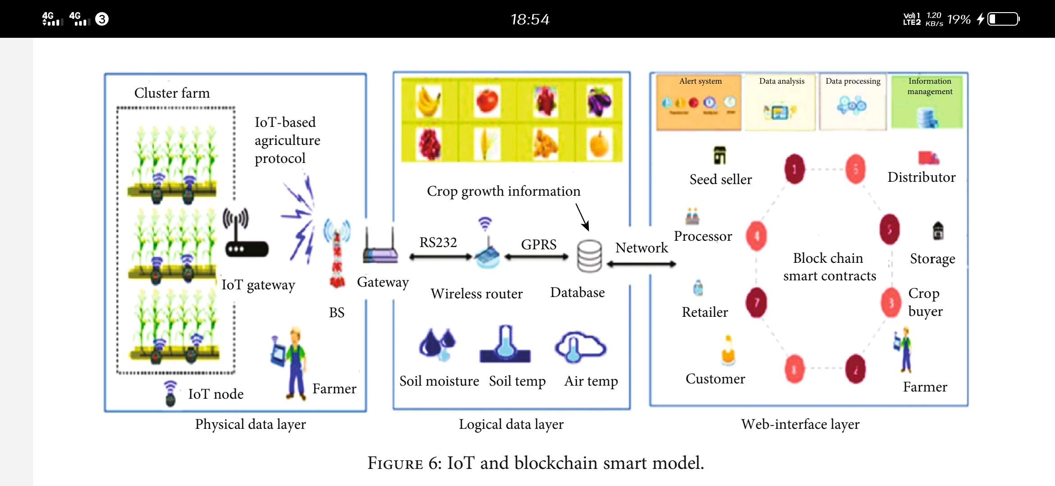

Slide 14
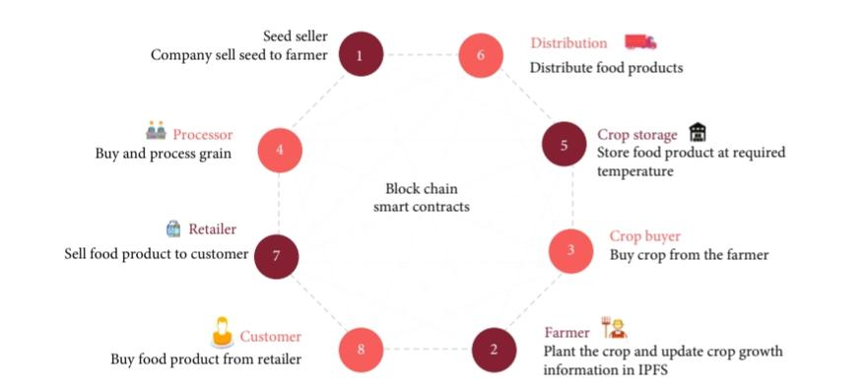
Block Chain Integration with IoT in the Smart Model
Exclusive blockchain characteristics will combine agricultural and food supply chain processes into a single smart system to ensure that consumers receive healthy food. Figure 7 shows a functional overview of the blockchain.
The role of stakeholders in the overall system is also discussed. The research used blockchain smart contracts to exchange data between mining nodes in the system. All business transactions are recorded in the shared ledger by mining nodes, and smart contracts receive all transactions in the blockchain in the form of function calls and generate activities, as well as providing access to parties involved in the transaction to exchange control track and receive alerts in the event of a violation. Finally, smart contracts help to maintain the best conditions and respond to food supply chain misappropriations.

Slide 15
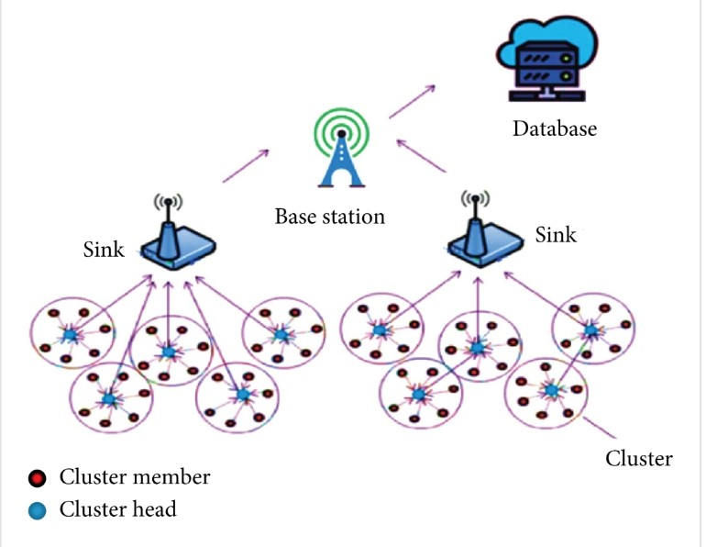
IoT-Based Agriculture Protocol for the Smart Model
IoT nodes are ideal for cluster farms because they consume less energy than WSN and can be further reduced through an efficient clustering protocol. Therefore, this research proposed a new clustering protocol IoT-based agriculture, as shown in Figure 8, based on the LEACH protocol, to reduce energy consumption and extend network life.

Slide 16
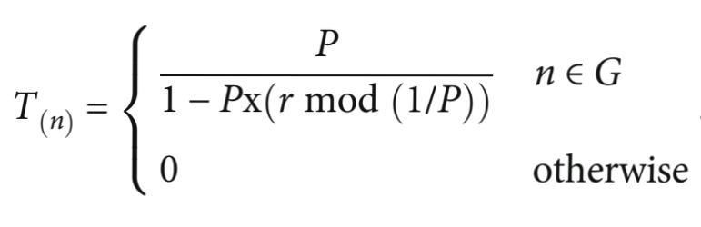
Process
Clustering Mechanism
IoT nodes are divided into groups in a cluster farm, and these groups are known as clusters; each cluster is represented by and has a head node. Each cluster’s nodes sense data and send it to a single head node; they do not communicate with other head nodes.
(1) Cluster Head (CH) Selection. The CH is responsible for collecting data from member nodes and transmitting aggregated data to the base station, it requires a lot of energy to do so, and the transmission process must be boosted with high power amplification. Two parameters are considered in the CH selection process: the history of nodes acting as CH and the optimal percentage of a node. The generation of a random number is used to make each node decision (between 0 and 1). The node will be selected as CH if the generated random number is threshold (Tn) for that round.
The following formula is used to calculate the threshold (Tn):
In equation (1), represents the percentage of CH, represents the number of rounds, and G represents the set of nodes that were not selected as CH in the previous 1/p rounds. Every node in the cluster has a 1/p chance of being a CH in each round in this situation. When a node is chosen as CH, it sends an advertisement message to its nearby nodes, inviting them to be CH. The advertisement message is accepted by the member nodes, and they enter the CH.

Slide 17
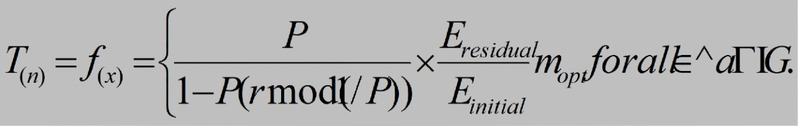
(2) Data Transmission. Following CH selection, the data transmission schedule kicks off, with member nodes sending data to their assigned CH during their designated transmission time. Low-energy transmission was required for this type of transmission. Before transmission time is allocated, the member node can be turned off to save energy. The CH must keep the receiver to receive the full data and then combine all of the data into a single signal before transmitting it to the base station via a sink node.
(3) Routing Phase. The way to pick a traffic route in a network is routing. The IoT agricultural network is comprised of numerous modes of communication and protocols in the long and short range, which form the backbone for these networks to gather information and exchange this data with the farmers for review and decision-making. The IoT-based agriculture protocol has three levels of data routing in the first stage member node sense data and transfer it to their CHs, while in the second stage, the CHs accumulate and transfer data to the nearest sink, and in the third and last stage, sink sends this data into the base station. In such data communication, the function of the sink minimizes CH’s energy consumption and reduces packet losses, especially for long haul communication. Figure 8 demonstrates the full data routing method.
(4) Setup Phase. For the first round, CHs are generated using the standard LEACH algorithm, and the cluster heads are chosen using equation (1). After transferring data, each node in the network consumes a specific amount of energy, and each node has consumed a different amount of energy. The distance between the sending and receiving nodes, denoted by “d” is an important factor in power consumption. As a result, the CH is chosen for the next round using an improved equation, as shown below.

Slide 18
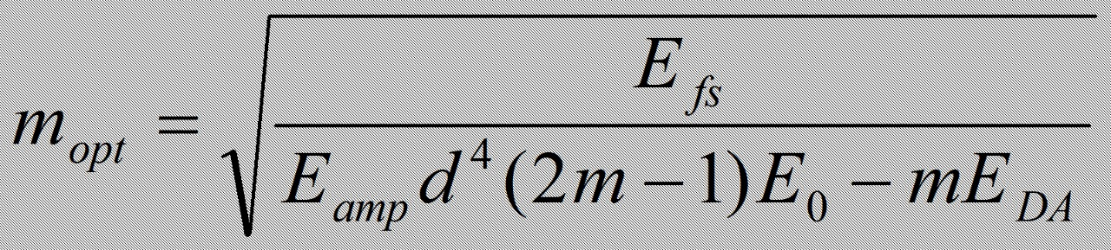
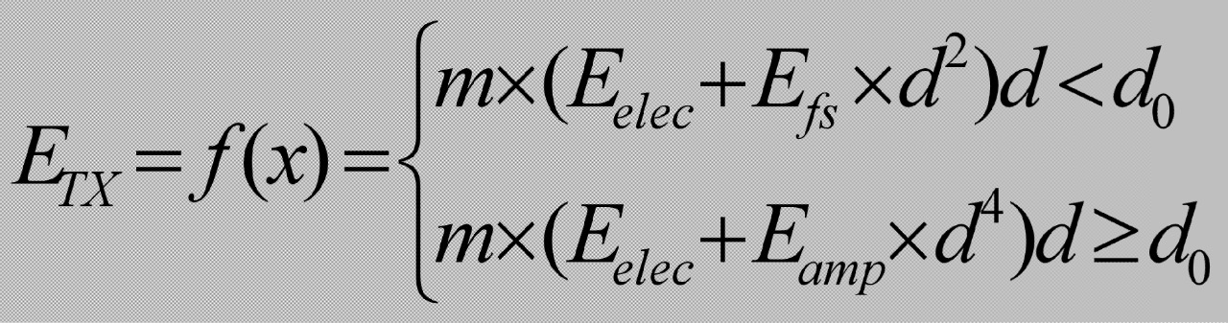
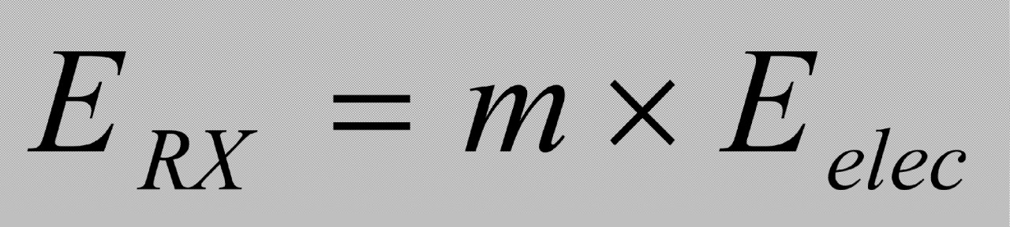
In above equation (5), Eresidual represents the node remaining energy, and Einitial is the initial energy assigned. Thus, mopt could be written as optimal number of clusters.
In the above equation (3), the is the optimal number of clusters, is the diameter of the network, whereas is the node initial energy. For data transmission, this research extended the first order radio model specified in equation (2) to compute the energy consumption.
where d_{o} presents distance threshold while ^{E}_{elec} and E_{fs} are denoted as energy dissipation with 50 nJ/bit and 10 pJ/bit/m² accordingly. m represents the packet size, and
E_{amp} is the multipath model of transmitter amplifier with 0.0013 pJ/bit/m4. Thus, ERX can be determined as it represents the receiving energy

Slide 19
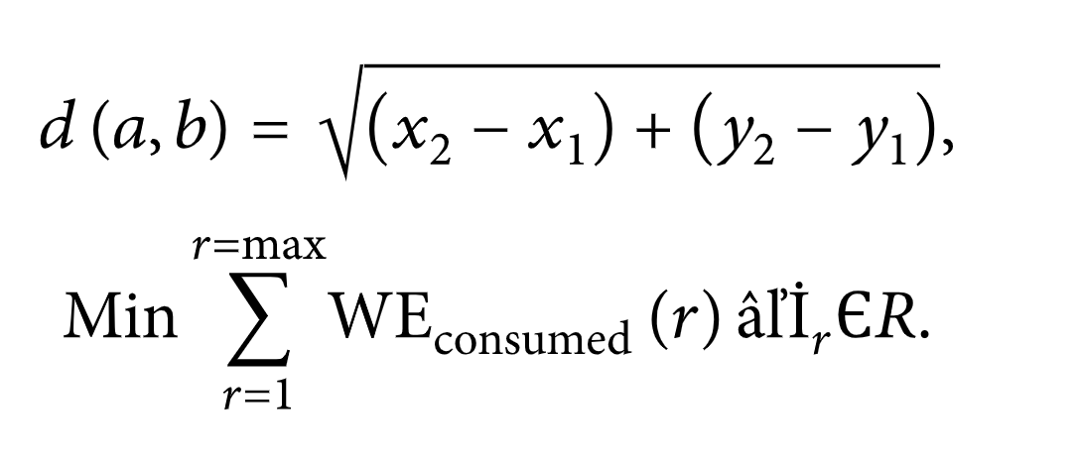
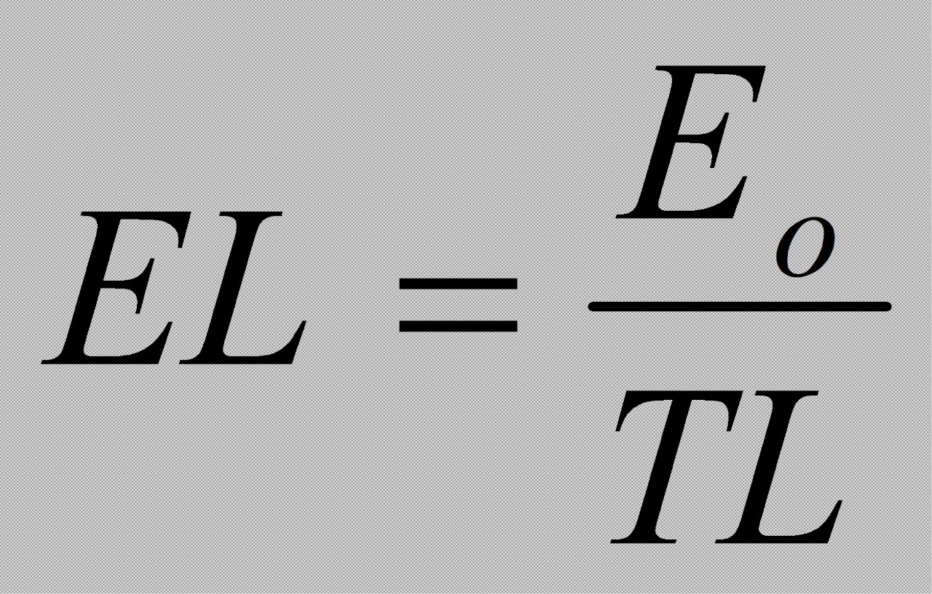
Because all nodes in the farm were deployed at random with the same initial energy, the sink node is deployed without energy constraints outside of the cluster farm, and nodes are informed of its location. In the first round, nodes report their location to the sink based on their signal strength. Those nodes that were chosen as grid heads (GH) begin performing their GH role and cease their previous role of data sensing during this process. Cluster heads are chosen as nodes with a high residual energy and a short Euclidean distance to sink and GH. The Euclidean distance between any two nodes a and b in the next two dimensions is calculated as follows:
WE consumed is calculated using equation by (4).
In the above equation, WE consumed is the amount of energy consumed in each round, and do denotes the distance between two nodes. The consumption of energy is assumed as ETX and ERX, and their parameters can be determined by using (2) and (3). To meet the objective mentioned in (5), this research divides the total node energy into different equivalent parts and presented as “EL” and can be calculated from (7)
In the equation (5), EL stands for energy level, stands for initial static node, and TL stands for total energy, which is dependent on the amount of energy consumed by each node as well as network density and packet size.

Slide 20
The relationship between EL and TL is inverse. When the TL value is low, the EL value is high. The node in the cluster farm performs the role of CH until the values of EL do not reduce the residual energy, at which point, a termination of CH selection message is sent to all nodes, and a new process for CH selection begins.
Only those nodes that are supposed to transfer data remain active in this mechanism to reduce energy consumption. When member nodes finish their data sensing process, CH begins to collect data from all member nodes, aggregate the data to remove any duplication, combine data into a single signal to save bandwidth, and transmit data in a single hop to the sink, where it is then transferred to the base station. The flowchart is shown in Figure 11, and the algorithm for the entire process is shown below.

Slide 21
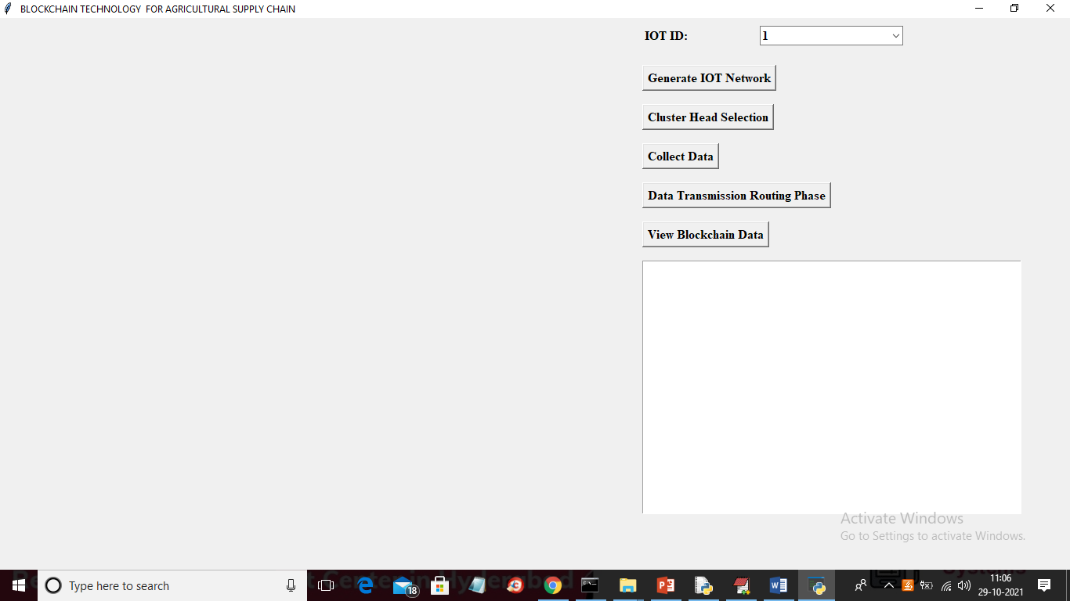
Result Analysis
To run project double click on ‘run.bat’ file to get below screen
In above screen click on ‘Generate IOT Network’ button to generate IOT simulation network and to get below screen

Slide 22
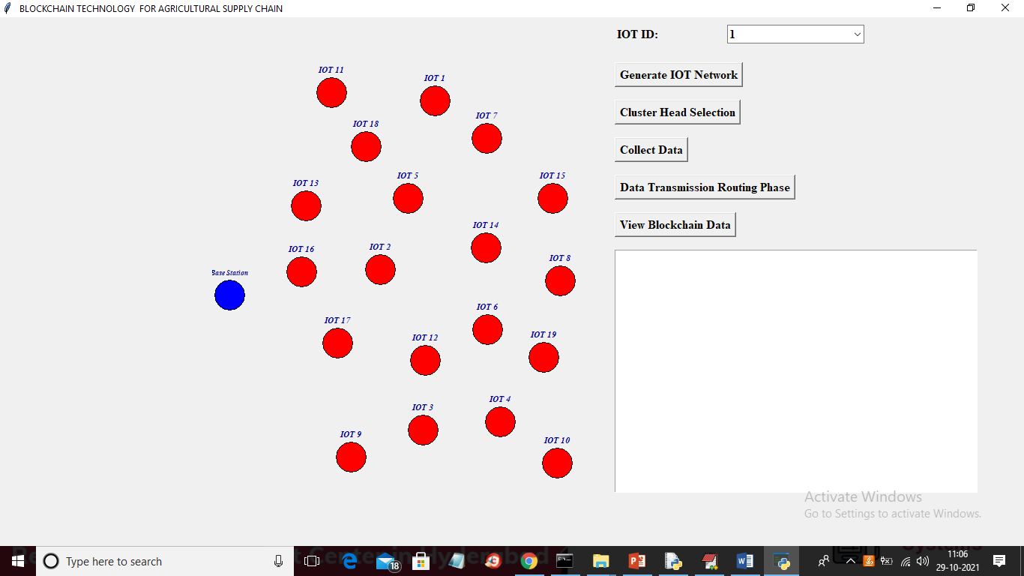
In above screen each red colour circle represents as IOT sensors installed in agriculture farms and blue colour circle represents Base Station. Now click on ‘Cluster Head Selection’ button to select cluster head with high available energy and can reach to more IOT with less distance to Base station

Slide 23
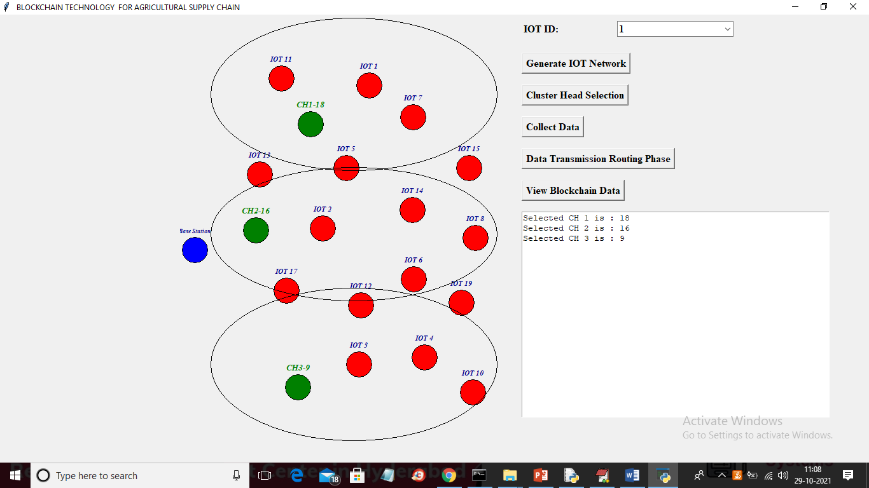
In above screen green colour IOT is selected as Cluster Head and all the IOT inside big oval will be consider as cluster member of that cluster and total 3 clusters are generated and now click on ‘Collect Data’ to enter some manual data as we don’t have any sensor to sense data so we collect data from keyboard manually

Slide 24
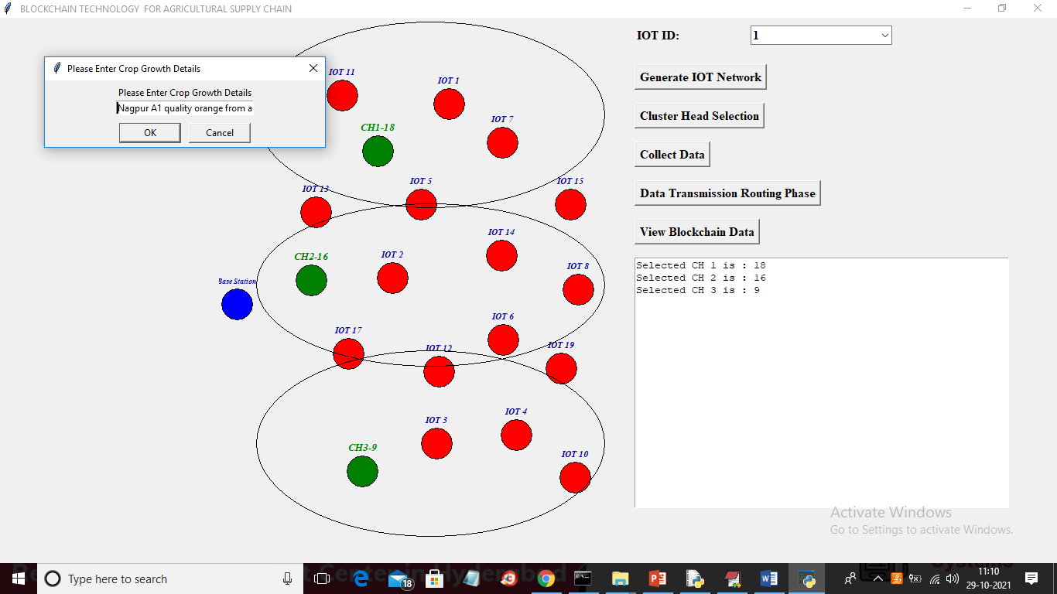
In above screen as data collection I entered some data and then click on ‘OK’ button to get below screen

Slide 25
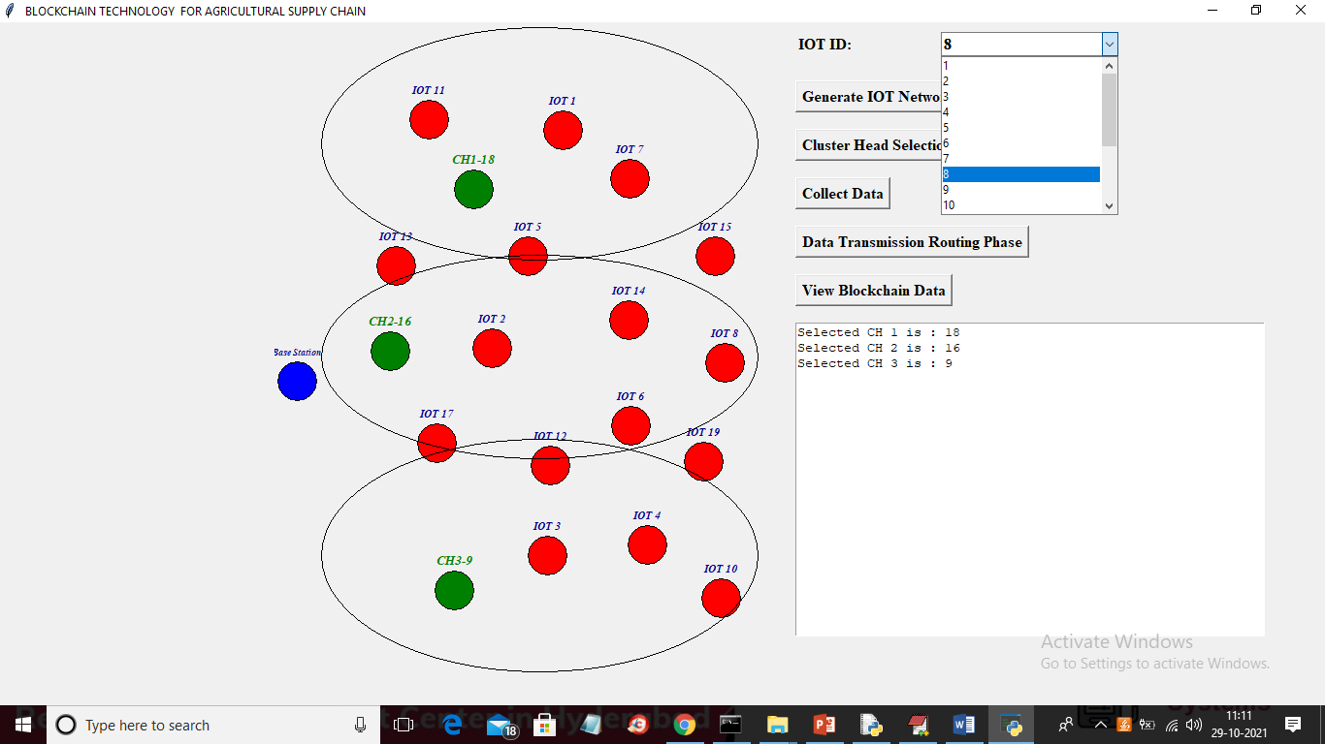
In above screen from IOT drop down box I selected sender IOT as 8 and then click on ‘Data Transmission Routing Phase’ button to allow IOT 8 to select shortest path to reached cluster head and then transfer data

Slide 26
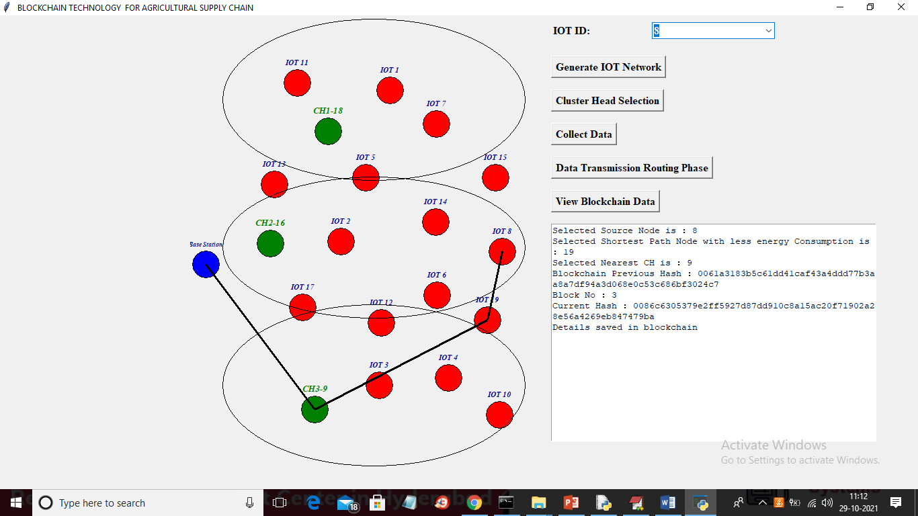
In above screen IOT 8 selected nearest hop as 9 and that 9 belongs to CH3 so it send data to CH3 and CH3 is sending data to base station and similarly you can select any IOT and then transfer data

Slide 27
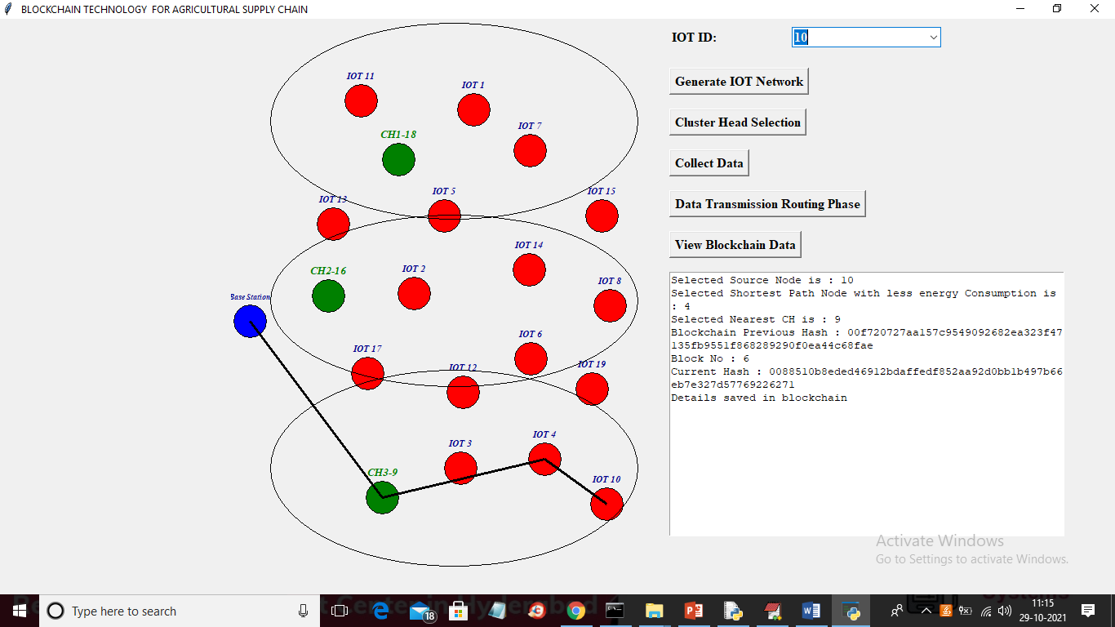
In below screen I selected IOT 10 and then it select CH 3 to send data to base station and in above screen we can see each data is stored at Blockchain and each block associated hashcode is also displaying and now select any IOT and click on ‘View Blockchain Data’ to extract data from Blockchain for selected ID

Slide 28
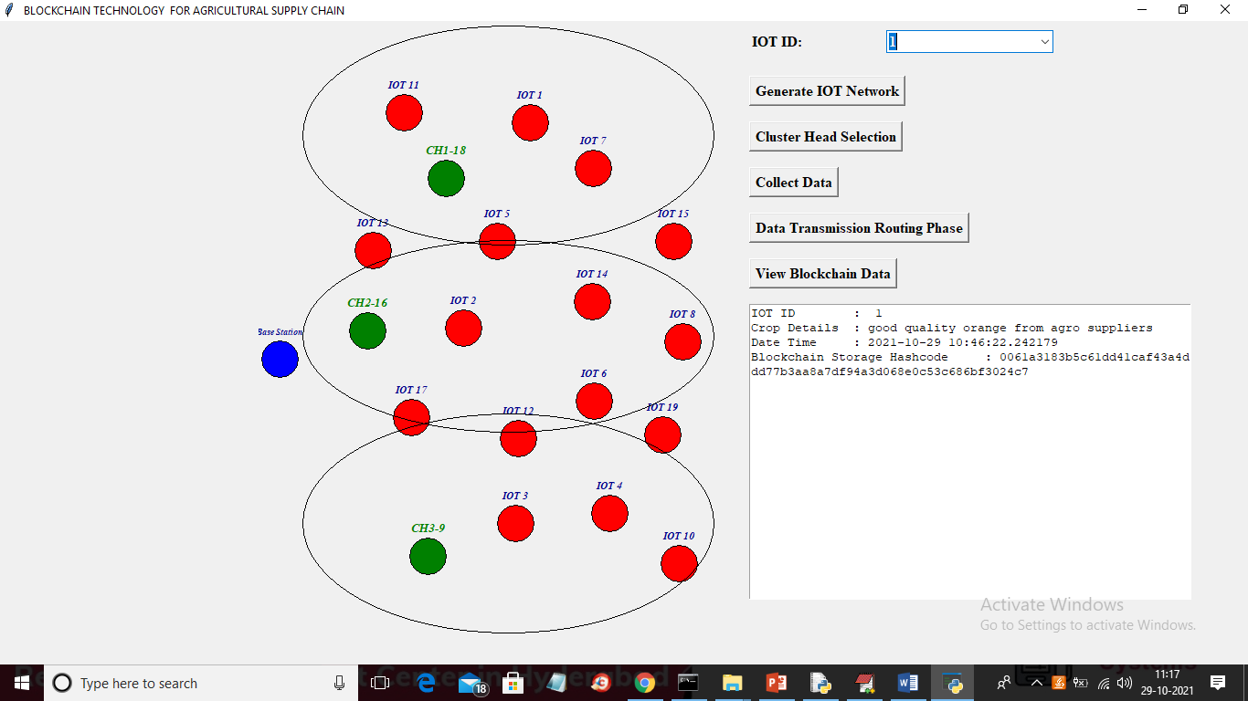
In above screen I selected IOT as 1 and then clicked on ‘View Blockchain Data’ button and then in text area all data for that IOT retrieve from Blockchain and then displaying and I am displaying hashcode of that block.

Slide 29
START
Initialization of IoT
Calculate residual
energy of each node
Clustering mechanism
Selection as CH/GH
No
Designated cluster
if RE is maximum
member
Yes
Control packet broadcasting
Data transferring from
Cluster member
Data transferring from
cluster member to CH/GH
If residual energy is
Yes
Broadcast end CH
less than threshold
role
No
Transfer aggregated data
to nearest sink
Transferring data from sink
to BS
END

Slide 30
Conclusion
Above Blockchain technology helps in detecting attack nodes and make data secured.
In propose work we are using IOT networks and this IOT network implemented following operations successfully,
Generate Network:
Cluster Head Selection:
Collect Data:
Data Transmission Routing Phase:
View Blockchain Data:
In this project we have used IOT sensors and agriculture field but we don’t have any sensors so we built this concept as simulation and analyzed successfully.

Slide 31
THANK YOU

